Slide 1
Problem Aim Objectives
Christopher I. Macintosh, PhD, RN
Notes:
Hello everyone
My name is Chris Macintosh. I help teach the capstone courses.
Today we’re talking about defining a specific aim and project objectives.
[Next slide]

Slide 2
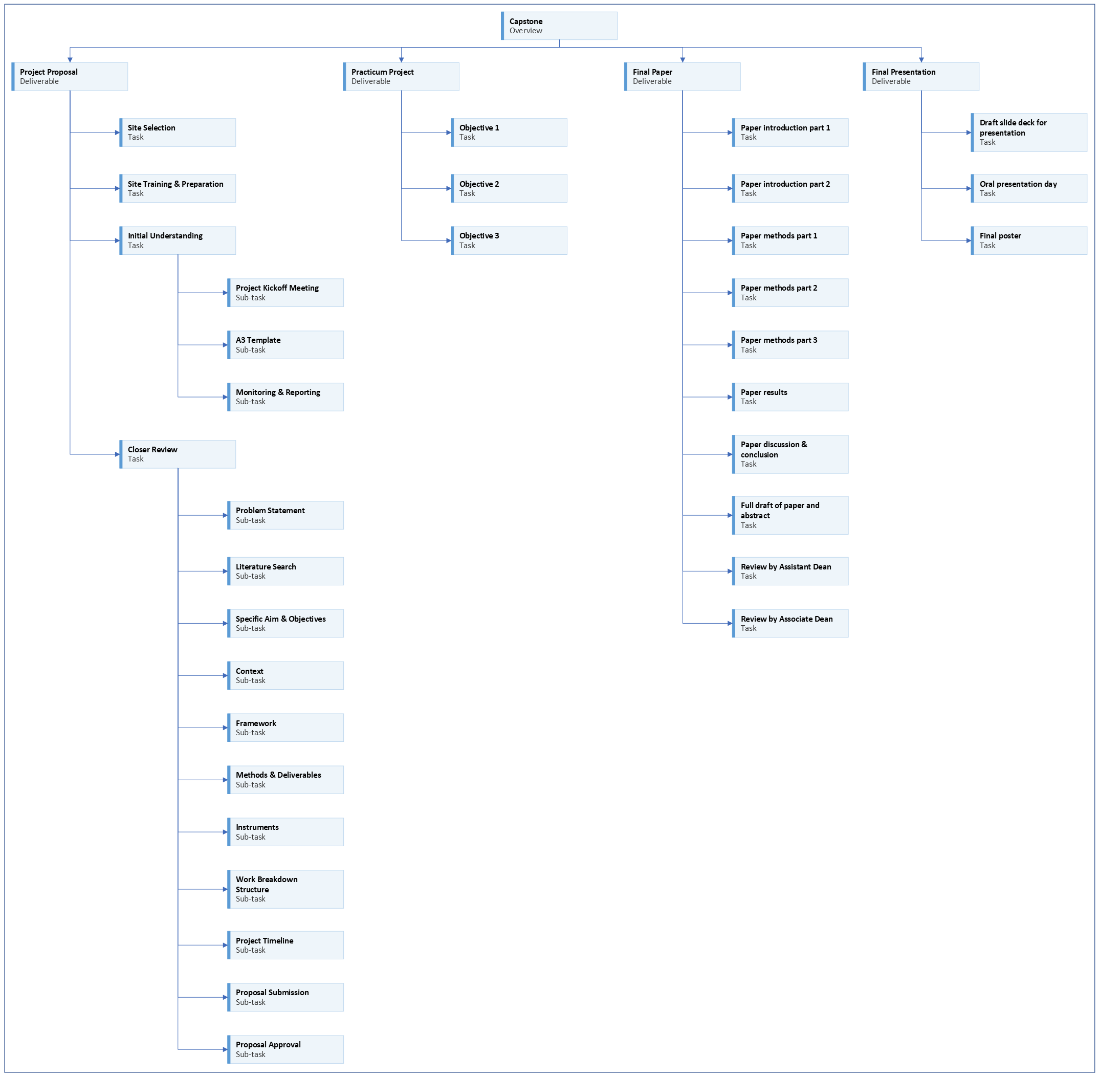
Notes:
We are working on the project proposal portion of your capstone.
[Next slide]

Slide 3
Notes:
Last time we talked about how to find relevant literature and take notes.
[Next slide]

Slide 4
Notes:
Today we’re going to talk about defining a specific aim and objectives.
[Next slide]

Slide 5





available knowledge
Notes:
You should continue working on the Available Knowledge section.
You should continue writing and add at least two more references.
As a reminder,
Information in this section should expand on what is written in the Problem Description section and be supported by evidence.
Use proper APA citations and references.
If you’re having trouble writing, just create bullet points that address the topics.
(Getting something down on paper is better than not writing anything.)
You will need to continue to add to the Available Knowledge section.
Eventually you should have 5-10 references in this section.
[next slide]

Slide 6
Project Aim
The purpose of this project is …
Notes:
The project aim is a succinct statement of what you’re trying to accomplish.
[click]
What is your overall target or goal?
It can start with the text, “The purpose of this project is…”
It should be a short statement of how you’re going to fix the problem you identified in your problem statement.
[next slide]

Slide 7
objectives
Verb + What needs to happen?
Example: Assess parents of adolescents with Type 1 diabetes for their previous use of anticipatory guidance information.
# of Objectives appropriate for project
Notes:
What do you need to do to accomplish your aim?
[click]
Objectives help identify the main steps in your project.
They help organize activities to reach the goal identified in your project aim.
An objective should consist of a measurable verb and what you would like to happen.
[click]
Here is an example.
Ask yourself if you need to assess, develop, implement, or evaluate?
You don’t need to get specific about how you’re going to go about it at this point.
We will do that in upcoming assignments.
These objectives are just general statements of what you intend to accomplish.
[click]
You only need as many objectives as is reasonable for the project.
You will need to determine your objectives with your project preceptor.
[next slide]

Slide 8
Clinical QI Objective examples
Identify primary care providers’ awareness and comfort levels regarding advanced care directives.
Develop a practice-specific clinical guideline supported by the most current and evidence-based recommendations.
Implement an educational presentation in a primary care setting.
Evaluate provider and staff knowledge and a change in advanced care CPT code use pre- to post- clinical guideline implementation.
Notes:
Here are some examples of different objectives.
[click]
Read
[click]
Read
[click]
Read
[click]
Read
[next slide]

Slide 9
Program evaluation Objective examples
Assess cancer patients’ knowledge about integrative medicine and health interventions.
Develop a presentation about potential benefits of mind-body awareness and qigong.
Implement a patient-accessible, modifiable qigong course for cancer patients and their caregivers.
Evaluate the impact of qigong practices on quality of life and fatigue in cancer patients and their caregivers.
Notes:
Here are some examples of different objectives.
[click]
Read
[click]
Read
[click]
Read
[click]
Read
[next slide]

Slide 10
Translation study Objective examples
Identify patients with HBA1C > 7% in a primary care setting.
Develop a clinical practice specific translation of Patten’s (2015) patient-centered, evidence-based intervention using problem solving.
Implement the evidence-based intervention using problem solving to improve frequency of self-reported self-monitored blood glucose testing.
Evaluate pre- and post-test measure of self-monitored blood glucose testing and patient change in SMBG testing at 3 months.
Notes:
Here are some examples of different objectives.
[click]
Read
[click]
Read
[click]
Read
[click]
Read
[next slide]

Slide 11
Innovation/needs assessment Objective examples
Assess current local intensive care unit staffing levels, patient acuity, admission rates, and staffing models.
Compare local findings with current research and identify potential barriers.
Develop and propose a collaborative ? Staffing model incorporating current research and ICU needs.
Evaluate stakeholders’ feedback on executive report and provide program implementation recommendations.
Notes:
Here are some examples of different objectives.
[click]
Read
[click]
Read
[click]
Read
[click]
Read
[next slide]

Slide 12
Questions to ponder
Do you need to assess or identify a phenomenon?
Do you need to develop a guideline, protocol, or algorithm?
Do you need to implement something?
Do you need to evaluate something you developed or implemented?
Notes:
Here are questions to think about.
[click]
Read
[click]
Read
[click]
Read
[click]
Read
[next slide]

Slide 13


Include evaluate objective
Notes:
[click]
Every project should have an Evaluate objective.
[click]
Even if you don’t get to see enough of your project completed to do the evaluation, you should still create an evaluation plan.
[next slide]

Slide 14
Example objectives
Graduate Nursing Projects
See MS and DNP project papers
https://library.med.utah.edu/publishing/collection/graduate-nursing-project/
Notes:
You can see more examples in other project papers.
[next slide]

Slide 15
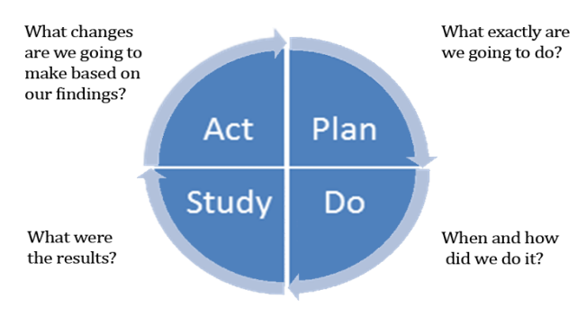
flexibility
Notes:
[click]
We have quite a bit of flexibility with these projects.
Despite our best-laid plans, sometimes things happen and circumstances change.
[click]
Sometimes we have to adjust the plan on the fly as we’re working on things.
[click]
Luckily, the quality framework we work in and the manuscript template have flexibility built in.
[click]
We can adjust things as plans and circumstances change.
[next slide]

Slide 16


assignment
Notes:
[click]
Your assignment is to write your overall project aim
And general project objectives to accomplish that aim.
[next slide]

Slide 17

More to come . . .
Notes:
That’s all we’ll do in this video.
There is more to come.
[next slide]

